Slide 1
ONLINE LIBRARY MANAGEMENT SYSTEM
Open Source Programming Project

Slide 2

GROUP MEMBERS
ANSHUL AGARWAL-15BIT0002
VINIT SHAHDEO-15BIT0335
ARCHIT ROY- 15BIT0259
TANUJ CHAKRABORTY- 15BIT0127
ANANYA CHAUDHARY-15BIT0052
IPSIT GAMBHIR-15BIT0202
Aryaman Dhawan- 15BIT0160

Slide 3
OVERVIEW
To build a library management which contains two login :- student and admin(librarian).
There will be various features like
Searching of books
Issuing and returning books
Paying fine(if any) online
Librarian can read information about any member
Librarian can track the books issued by a particular student

Slide 4

Module 1 - Student Login / Admin Login
Authentication of the user will be there.
Username and password will be matched from our database. Once both username and password matches, then only a user is allowed to enter into the system.
Similarly for admin there will be a authentication system.

Slide 5
Module 2 - Signup For New Uses
For new users there will be sign up option
Various details like registration number , username , password etc. will be taken from the user and then it will be updated in our database.
After this , the user will be redirected to the login page.

Slide 6
Module 3 - Student Profile
After successful login into system, user can see its details
Various details which will be shown are:-
Issued books
Date of issue
When to return
Current fine the user has to pay
Searching book in the library.

Slide 7
Module 4 - Admin Panel
After successful login admin can keep track of the books issued
It can also track various other details such as
Fine of all students.
Which book is issued by the student
The number of copies of book which can help the librarian to know which book to order.

Slide 8
Module 5 – Book Search
Books present in the library can be searched
The books can be searched on various parameters such as
Subject wise Search- If a student wants a book related to open source programming then system will show all the books related to osp present in the library .
Author Wise Search- Can search a book on particular author. The system will show all the books on that author available in the library
Year Wise Search- Searching a book based on particular edition will be available.

Slide 9
Module 6 - Book Recommendation
In this , user will be allowed to recommend any book he/she require .
This information will go into the admin login where he can inform the higher authorities for supply of the books.

Slide 10
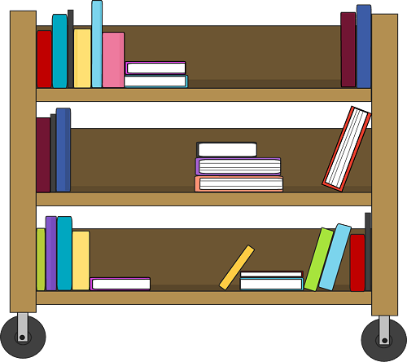
Module 7 - Feedback
Feedback will be taken from the user related to our system and all the feedback will be stored in a database and will be displayed in admin login which will help us to remove all the bugs and improve our library management system.

Slide 11

Other Functionalities
Like in Facebook until and unless the user logs out whenever he goes on the website his/her session remains active. Similarly in our management system the user will not be logged out from the system until he clicks on the logout button .

Slide 12
ER DIAGRAM
It is clear that the physical objects from the previous section – the member, books, library – correspond to entities in the Entity-Relationship model, and the operations to be done on those entities – holds, checkouts, and so on – correspond to relationships. However, a good design will minimize redundancy and attempt to store all the required information in as small a space as possible.

Slide 13
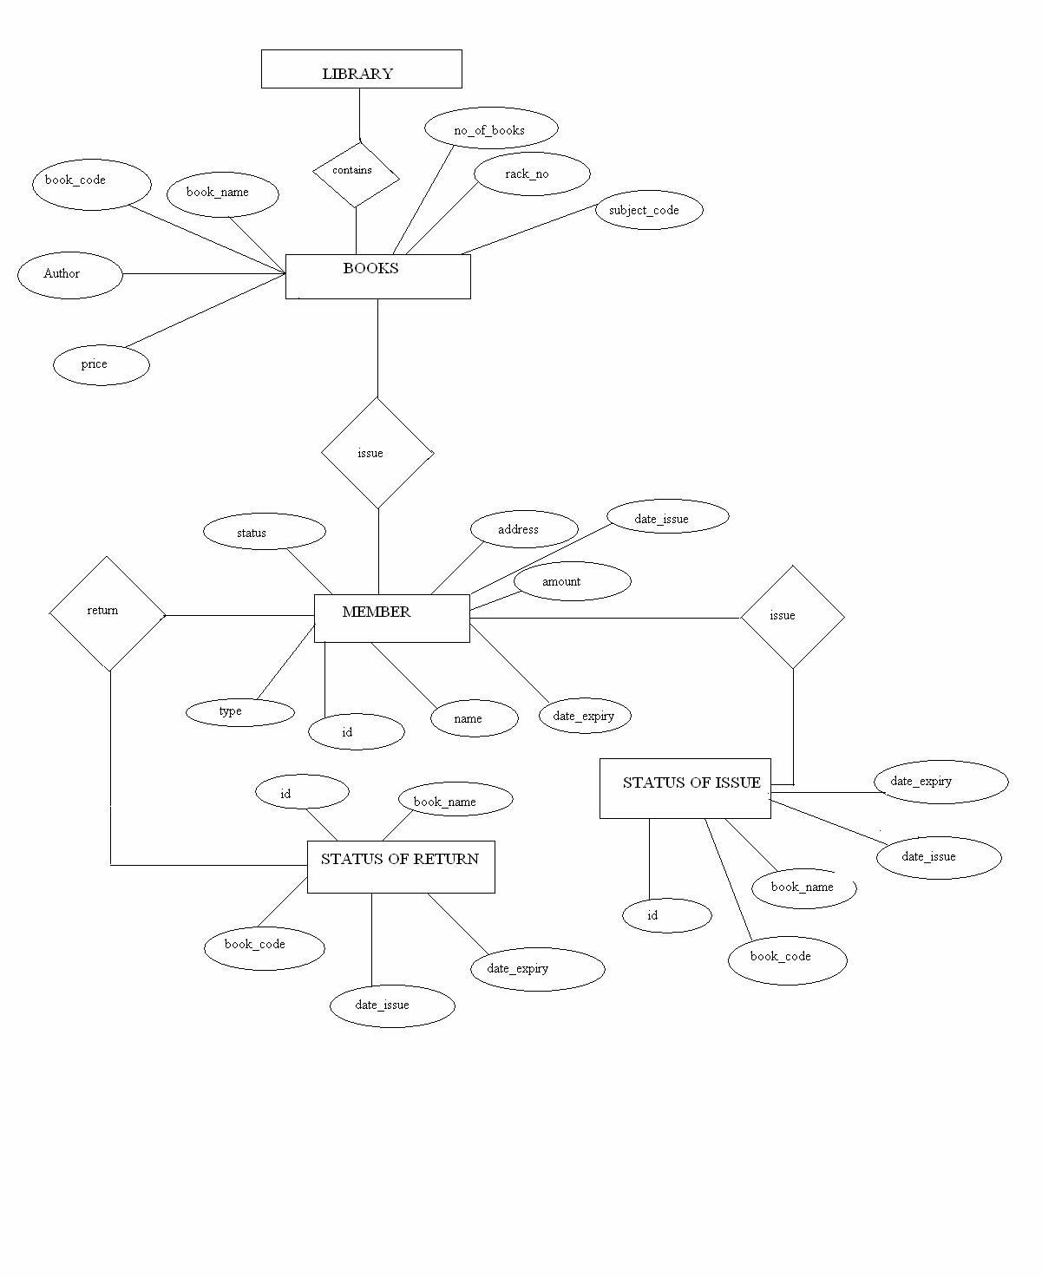

Slide 14
THANK YOU!!

